Slide 1
CSCI 631 Foundations of Computer Vision
Ifeoma Nwogu
ion@cs.rit.edu

Slide 2
Today
Logistics
Staff, Labs, prerequisites, textbooks, grading etc
Course Organization
What is computer vision?
Why is vision so hard?
Course goals

Slide 3
Course Staff
Instructor: Ifeoma Nwogu
Office hours:
Tues and Thurs
2:30-3:20pm
70-3669
also by appointment as needed
Teaching Assistant: Brij Ketan Shah

Slide 4
LABs
Two hours of lab time each week
Saturdays mornings from 10am till noon (can change)
Focused on related software installation and assistance with programming homework
TA’s office hours will be at the lab

Slide 5
Prerequisites
This course is appropriate for students with these essential prerequisites:
A good working knowledge of Python, especially Numpy
Working knowledge of linear algebra
Some vector calculus
The course does not assume prior imaging experience, computer vision, image processing, or graphics

Slide 6
Textbooks
No expensive physical textbooks
Tutorials
OpenCV Tutorials as https://docs.opencv.org/master/d9/df8/tutorial_root.html
Deep learning tutorials online, especially using Pytorch
Research papers
Programming homework will sometimes be accompanied by related past research papers

Slide 7
Modules
First module of the course will be classical methods of computer vision. These involve
Directly manipulating of pixels in images (image processing)
Extracting hand-engineered features; and
Applying basic machine learning techniques for solving problems in computer vision; e.g. classification with SVM, regression, segmentation via clustering features, etc.

Slide 8
Modules cont’d
Second module will include the basic architectures of a neural network. These involve
Logistic regressor and multi-level perceptron (MLP)
CNN for analyzing images
RNN and its extensions (LSTM and GRU) for analyzing sequences of images (videos)
Midterm 1 will happen after Module 2

Slide 9
Modules cont’d
Module #3 deals with motion in vision. There are 3 sub-parts to this module:
Estimating the direction and intensity of motion using optical flow
Analyzing motion using statistical models (hidden Markov models; HMM)
Analyzing motion using deep neural networks for sequences such as LSTM or GRU
This is a very ambitious module!

Slide 10
Modules cont’d
The last module deals with advanced vision algorithms.
Object detection and segmentation
Deeper imaging architectures (ResNet; Inceptions; variants)
We will look at Autoencoders and Transfer learning methods
And review interpretability of these networks via class activation maps
Midterm 2 will happen after Module #4

Slide 11
Programming
The course will involve programming in Python, specifically the use of Numpy (+ supporting libraries for plotting, reading datasets, etc.) and pyTorch libraries for deep learning.

Slide 12
Grading
There will be five components to the course grade
5-7 programming assignments (35)
4-5 reading assignments (10)
2 mid-term exams (30)
Final conference paper presentation (10)
Final project result presentation (15)
Active positive participation (extra 5)
Class participation is strongly encouraged to offset negative performance in any of the above
Extra credits will be given for active positive participation on myCourses discussion

Slide 13
Final presentation
Teams of 2-3 encouraged
These are the same teams for the final project
Detailed review of CVPR-type paper
Presentation of the paper in class
Clearly articulate the relevance/benefits of the work
Demonstrate clear understanding of the technical aspect of the work
Critical reviews are strongly encouraged

Slide 14
Final project
Significant implementation of a technique related to the course content
Teams of 2-3 encouraged
CVPR-type review article
Two components :
proposal document (no more than 2 pages)
final write-up with results (no more than 6 pages CVPR style)

Slide 15
Academic Integrity
What Is Academic Integrity?
https://www.rit.edu/academicaffairs/policiesmanual/d080
Pls review; ignorance is not the same as innocence
Plagiarism; cheating; duplicate submission for credit
Dr. HP Bischoff handles AI problems in the department
Deans Committee for Academic Integrity Violations

Slide 16
Mental Health Initiative
Success in this course depends heavily on your personal health and wellbeing. Recognize that stress is an expected part of the college experience, and it often can be compounded by unexpected setbacks or life changes outside the classroom. Your other instructors and I strongly encourage you to reframe challenges as an unavoidable pathway to success. Reflect on your role in taking care of yourself throughout the term, before the demands of exams and projects reach their peak. Please feel free to reach out to me about any difficulty you may be having that may impact your performance in this course as soon as it occurs and before it becomes unmanageable. In addition to your academic advisor, I strongly encourage you to contact the many other support services on campus that stand ready to assist you.

Slide 17
Course goals
Be aware of the value and ethical problems of computer vision to society
Understand CV pre-deep learning methods and when old tricks might come in handy
Understand the basics of deep learning from first principles
Obtain a level of comfort implementing advanced deep learning algorithms for vision
Understand how to analyze moving data

Slide 18
Examples of mainstream vision applications
The next slides show some examples of what current vision systems can do

Slide 19
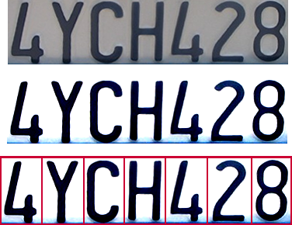

Optical character recognition (OCR)
Technology to convert scanned docs to text
If you have a scanner, it probably came with OCR software
Digit recognition, AT&T labs
http://www.research.att.com/~yann/
License plate readers
http://en.wikipedia.org/wiki/Automatic_number_plate_recognition

Slide 20
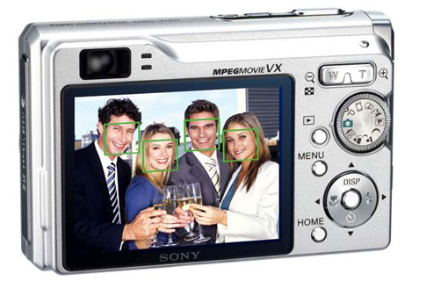
Face detection and recognition
Notes:
Why would this be useful? Main reason is focus. Also enables “smart” cropping.

Slide 21
Smile detection
Sony Cyber-shot® T70 Digital Still Camera

Slide 22
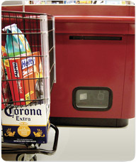
Object recognition (in supermarkets)
LaneHawk by EvolutionRobotics
“A smart camera is flush-mounted in the checkout lane, continuously watching for items. When an item is detected and recognized, the cashier verifies the quantity of items that were found under the basket, and continues to close the transaction. The item can remain under the basket, and with LaneHawk,you are assured to get paid for it… “

Slide 23
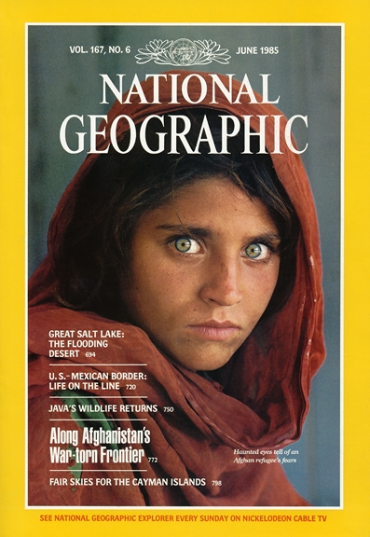
Face recognition
Who is she?

Slide 24
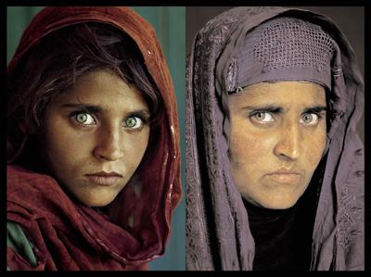
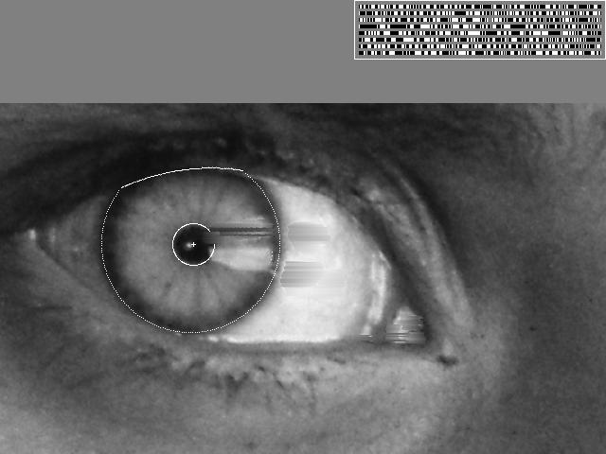
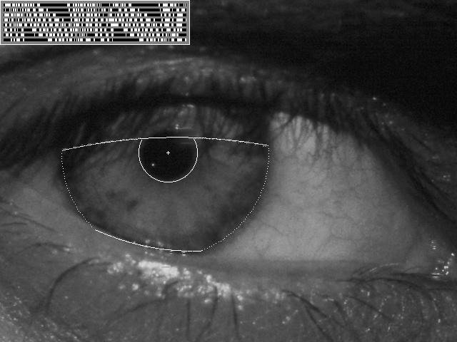
Vision-based biometrics
“How the Afghan Girl was Identified by Her Iris Patterns” Read the story

Slide 25

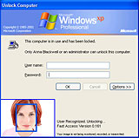


Login without a password…
Fingerprint scanners on many new laptops, other devices
Face recognition systems now more widely used http://www.sensiblevision.com/

Slide 26
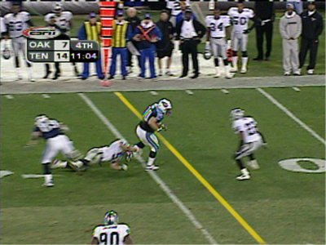
Sports
Sportvision first down line
Nice explanation on www.howstuffworks.com

Slide 27
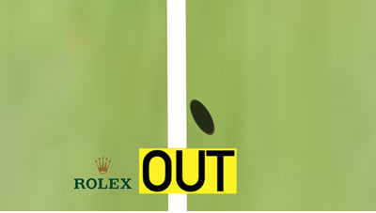
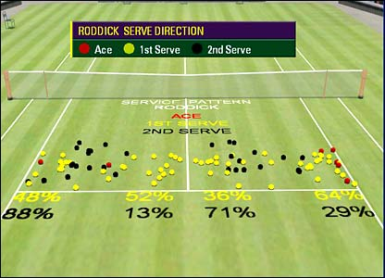
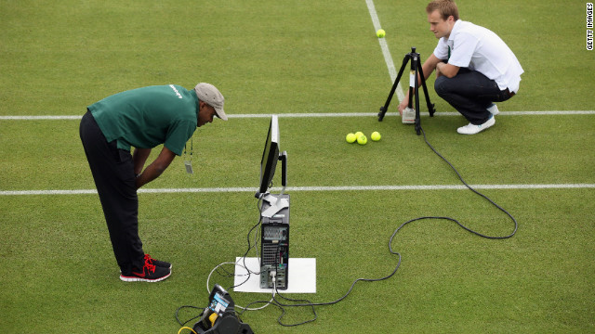
Sports
Brief explanation on how hawk-eye works can be found here

Slide 28
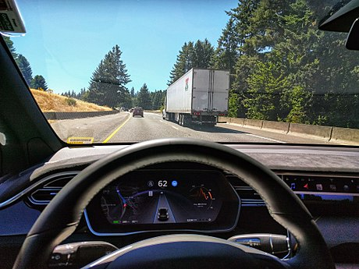
Smart cars
Level 0: Automated system issues warnings but no sustained vehicle control.
Level 1 ("hands on"): Driver and the automated system share control of the vehicle. e.g. Adaptive Cruise Control
Level 2 ("hands off"): Automated system takes full control (accelerating, braking, and steering). Driver must monitor the driving and be prepared to intervene at any time
Level 3 ("eyes off"): The driver can safely turn their attention away from the driving tasks, e.g. the driver can text or watch a movie. Vehicle will handle situations like emergency braking.
The 2018 Audi A8 Luxury Sedan was the first commercial car to claim to be capable of level 3 self driving.
Level 4 ("mind off"): As in level 3, but no driver attention is ever required for safety, i.e. the driver may safely go to sleep or leave the driver's seat. Self driving is supported only in limited spatial areas (geofenced) or under special circumstances, like traffic jams.
Level 5 ("steering wheel optional"): No human intervention is required at all. An example would be a robotic taxi.
Tesla Autopilot system is considered to be an SAE level 2 system

Slide 29
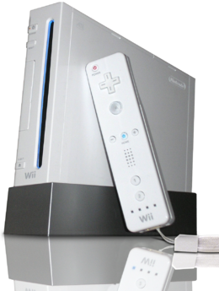
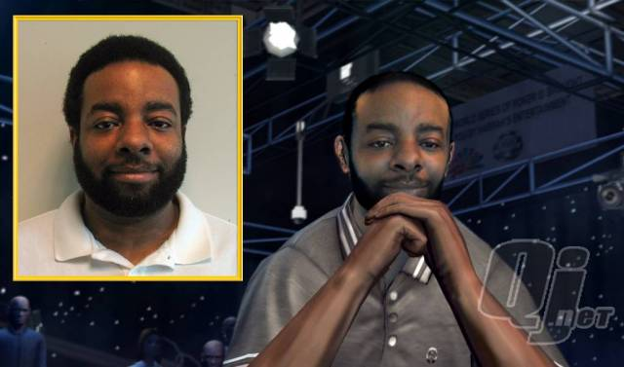
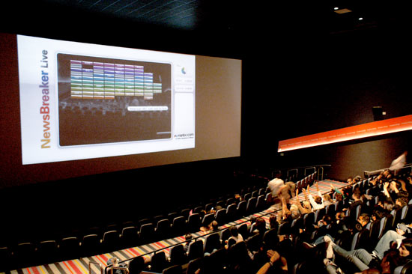
Vision-based interaction (and games)
Digimask: put your face on a 3D avatar.
Nintendo Wii has camera-based IR tracking built in. See Lee’s work at CMU on clever tricks on using it to create a multi-touch display!
“Game turns moviegoers into Human Joysticks”, CNET
Camera tracking a crowd, based on this work.

Slide 30
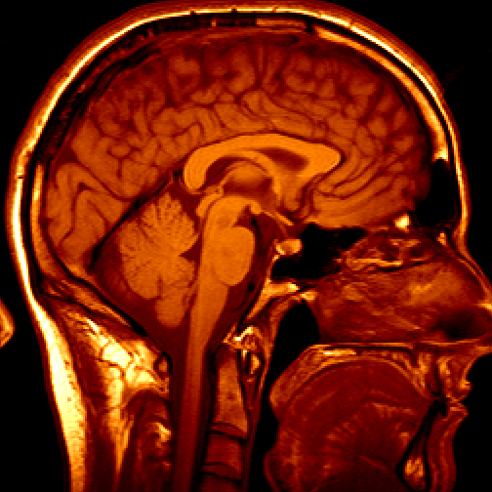
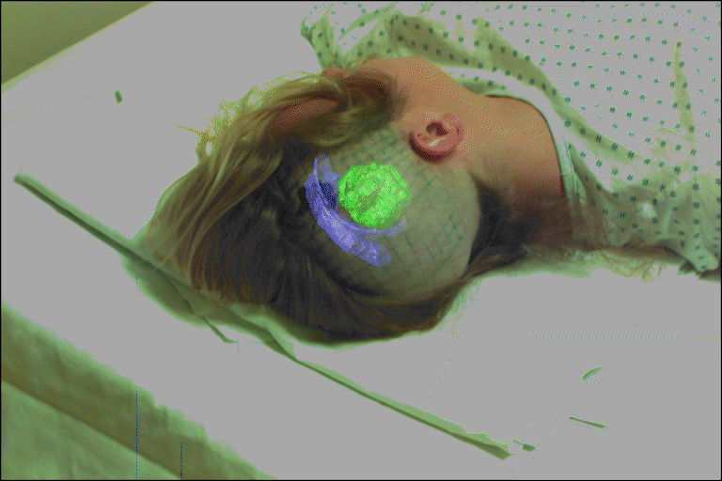
Medical imaging
3D imaging
MRI, CT
Image guided surgery
Grimson et al., MIT

Slide 31
More recent applications
Many more applications of advanced vision algorithms making their way to the public:
Video-conferencing-based communication coach
Face-to-face interaction quality, e.g. between therapist and client; student and mentor; etc
Automated warehouses (Amazon robots, etc)
Robot knife for surgery
Cassava leaf health monitoring
So may more….

Slide 32
Related disciplines
Other…
Behavioral science
Medicine
Artificial intelligence
Machine learning
Graphics
Computer vision
Image processing
Cognitive science
Algorithms

Slide 33
Linear Filtering

Slide 34
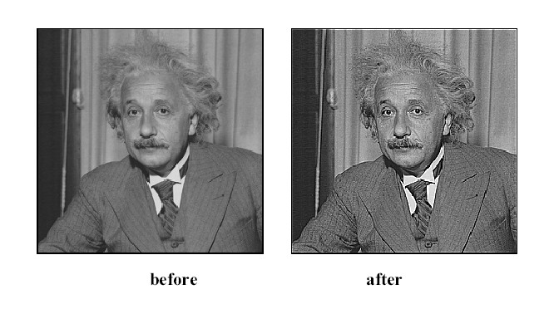

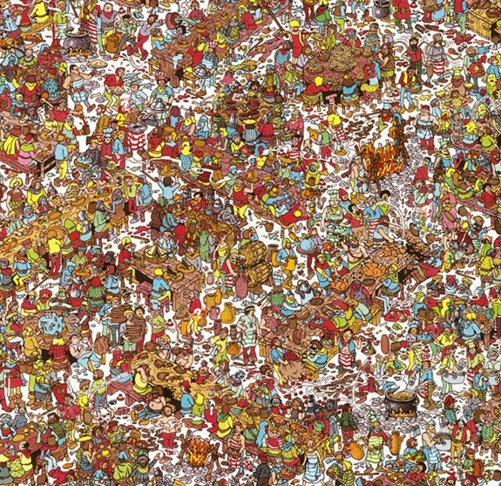
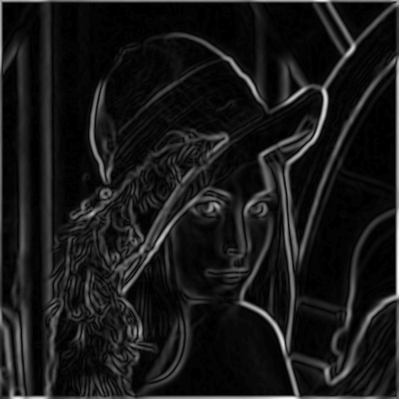
Image Filters
Smooth/Sharpen Images... Find edges... Find waldo…

Slide 35
Images as functions
We can think of an image as a function, f, from R² to R:
f( x, y ) gives the intensity at position ( x, y )
Realistically, we expect the image only to be defined over a rectangle, with a finite range:
f: [a,b] x [c,d] → [0, 1.0]
A color image is just three functions pasted together. We can write this as a “vector-valued” function:
Source: S. Seitz

Slide 36
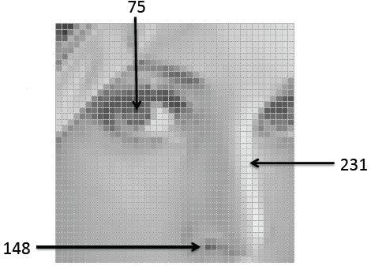
Images as functions
An image contains discrete number of pixels, e.g.
“grayscale” (or “intensity”): [0,255]
Source: F.F Lei

Slide 37
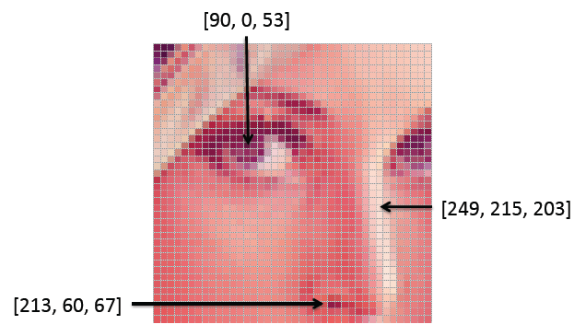
Images as functions
An image contains discrete number of pixels, e.g.
“grayscale” (or “intensity”): [0,255]
Color
RGB: [R, G, B]
Lab: [L, a, b]
HSV: [H, S, V]
Source: F.F Lei

Slide 38

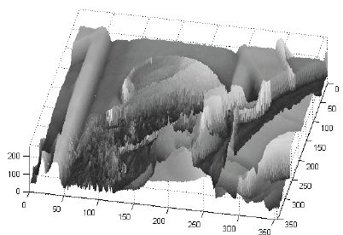
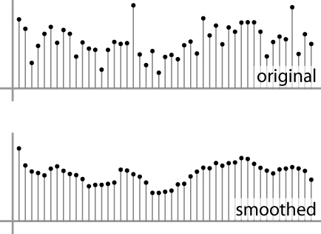
Images as discrete functions
In computer vision we operate on digital (discrete) images:
Sample the 2D space on a regular grid
Quantize each sample (round to nearest integer)
Image thus represented as a matrix of integer values.
2D
1D

Slide 39
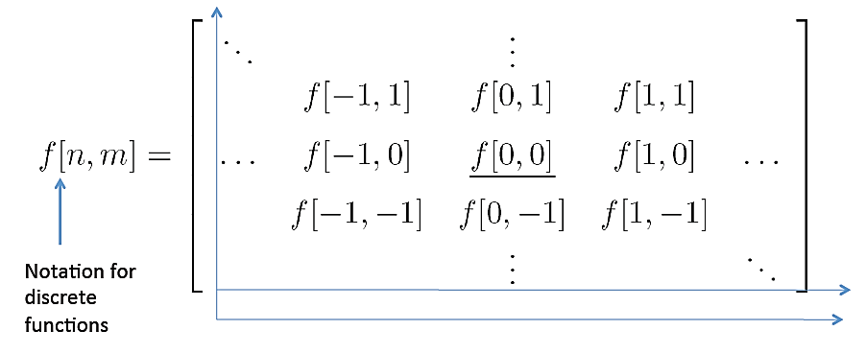
Images as discrete functions
Cartesian coordinates

Slide 40
Motivation
Filtering:
Form a new image whose pixels are a combination original pixel values
Goals:
Extract useful information from the images
Features (edges, corners, blobs…)
Modify or enhance image properties:
super-­resolution; in-painting; de­‐noising

Slide 41
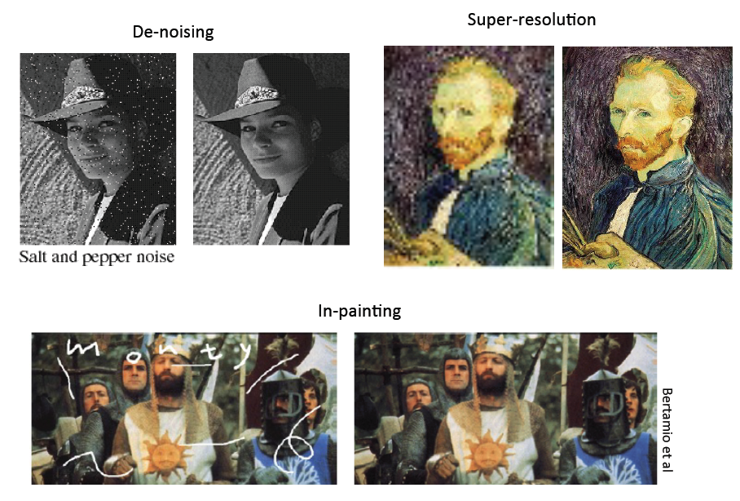
Source: F.F. Li

Slide 42

Questions

